Slide 1

Affinity Propagation: A Clustering Algorithm
Affinity Propagation is a powerful clustering algorithm that identifies clusters without requiring the number of clusters as input. It works by passing messages between data points, ultimately determining cluster centers and assignments.

Slide 2
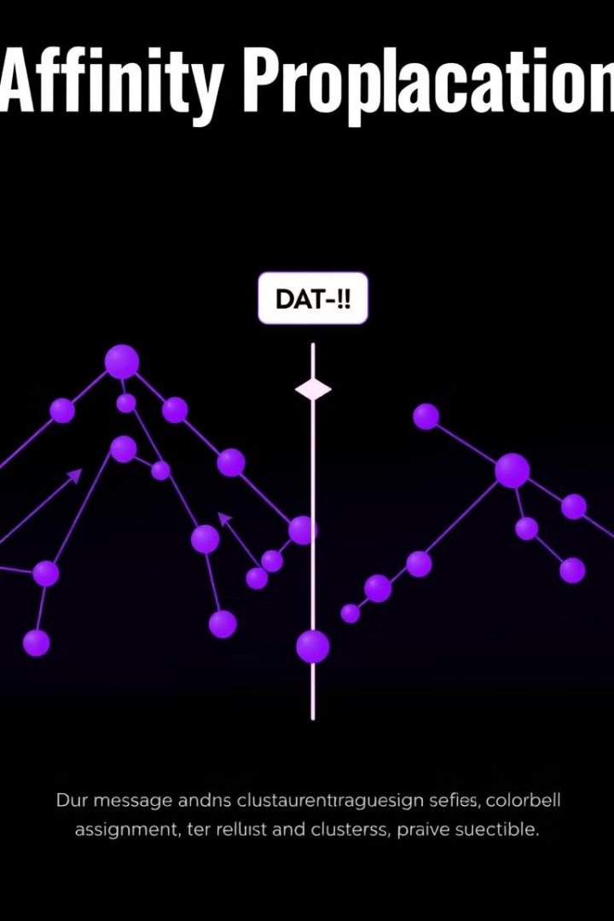
How Affinity Propagation Works
1
Similarity Matrix
2
Preference Values
Affinity Propagation relies on a similarity matrix that quantifies the similarity between each pair of data points.
Preference values reflect how likely a data point is to become a cluster center, influencing the message passing process.
3
Message Passing
The algorithm iteratively updates messages between data points, converging to a stable solution that identifies cluster centers and assigns data points to clusters.

Slide 3
Advantages and Disadvantages
Advantages
Disadvantages
No need to specify number of clusters
Computational cost for large datasets
Handles complex data distributions
Sensitivity to parameter settings
Identifies clusters of arbitrary shapes
May not always find the optimal clustering

Slide 4
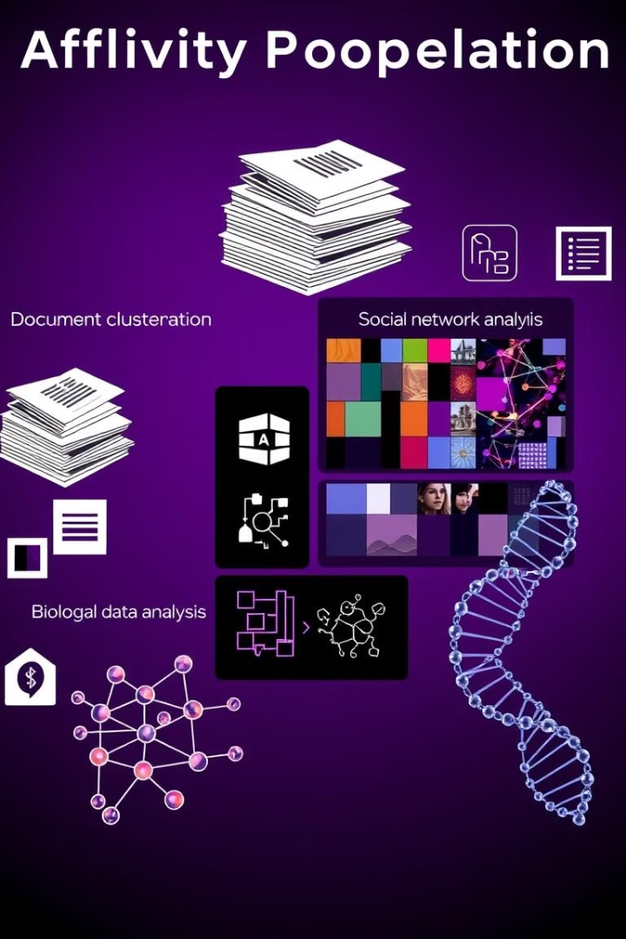
Applications of Affinity Propagation
Document Clustering
Image Segmentation
Clustering documents based on their content similarity, useful for information retrieval and document organization.
Grouping pixels in an image based on color, texture, or other features, facilitating image analysis and object recognition.
Biological Data Analysis
Analyzing gene expression data, identifying groups of genes with similar expression patterns, advancing research in genomics and bioinformatics.

